Slide 1
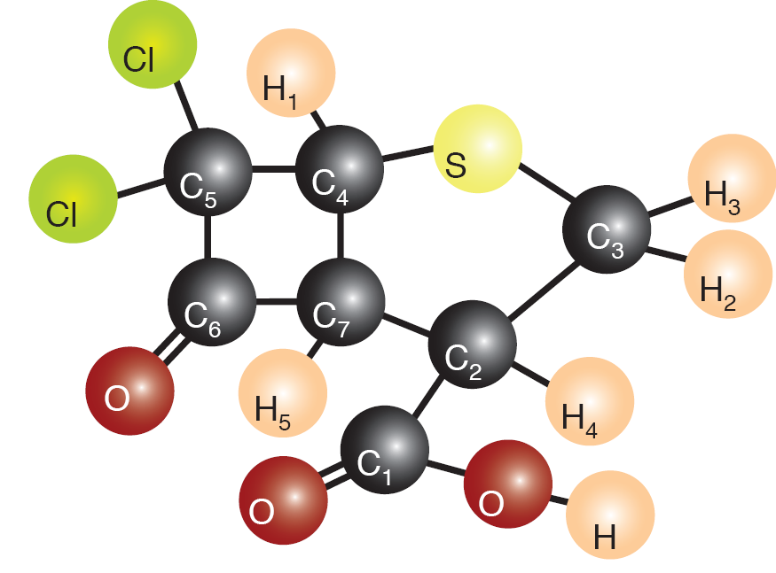

 | C1 | C2 | C3 | C4 | C5 | C6 | C7 | H1 | H2 | H3 | H4 | H5
C1 | 30020
C2 | 57.58 | 8779
C3 | -2.00 | 32.70 | 6245
C4 | 0 | 0.30 | 0 | 10333
C5 | -1.25 | 2.62 | 1.11 | 33.16 | 15745
C6 | 5.54 | -1.66 | 0 | -3.53 | 33.16 | 34381
C7 | 1.25 | 37.48 | 0.94 | 29.02 | -21.75 | 34.57 | 11928
H1 | 0 | 0 | 2.36 | 166.6 | 4.06 | 5.39 | 8.61 | 3310
H2 | 4.41 | 1.86 | 146.6 | 2.37 | 0 | 0 | 0 | 0 | 2468
H3 | 1.81 | 3.71 | 146.6 | 2.37 | 0 | 0 | 0 | 0.18 | -12.41 | 2158
H4 | -13.19 | 133.6 | -6.97 | 6.23 | 0 | 5.39 | 3.78 | -0.68 | 1.28 | 6.00 | 2692
H5 | 7.87 | -8.35 | 3.35 | 8.13 | 2.36 | 8.52 | 148.5 | 8.46 | -1.06 | -0.36 | 1.30 | 3649
T1 | 8.015 | 3.611 | 1.834 | 3.722 | 12.95 | 8.157 | 3.636 | 3.831 | 2.128 | 2.278 | 2.654 | 3.472
T2 | 1.611 | 0.877 | 1.122 | 0.792 | 1.143 | 1.912 | 0.531 | 0.337 | N/A | N/A | 0.318 | 0.276
C-13 labeled 12-qubit system
$$\text{Dichloro}\text{−}\text{cyclobutanone}$$

